Slide 1
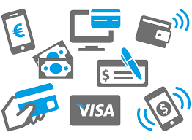
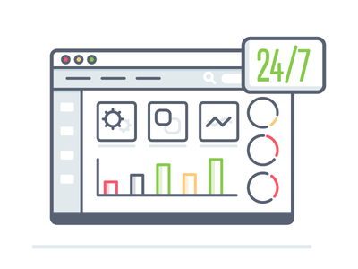
Integrated Payment
Gateway
There will be Integrated Payment gateway for Payment Collection in every Payment Collection Screens of every module via different payment methods like Paytm, BHIM, UPI, Debit Cards & Credit Cards.
Organizational Progress
Dashboard
Collectorate, DDO, TDO, DMO, Mamlatdar, Prant Officer etc. will have their personal logins. Upon login to their accounts they will have their respective dashboard, where they can review their undercharge organizational Progress and wide range of reports.
Organizational
Comparison Parameters
Comparison of different organizations will be on single platform and very easy to access. Comparisons will be made based on different parameters like, Income, Expense, Development, Recovery, Registration etc.
Categorized
Organization Ranking
Based on different performance parameters, each organization will be assigned a rank. This will help categorize organizations in each terms of progress and development. Also it will empower and encourage officers and employees for ranking betterment.

Slide 2
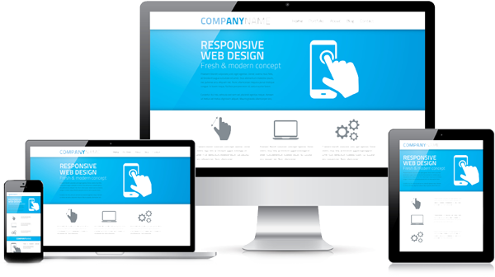
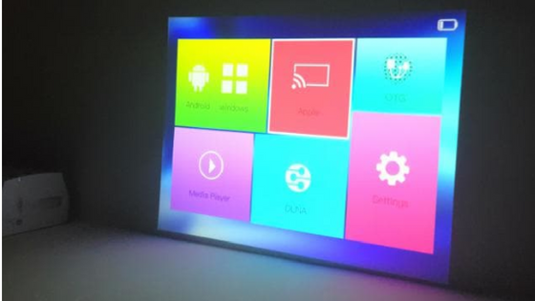
No Installation
Required
To run the system, no need to do the system installation by spending long hours. Just Connect with internet, enter the URL and start accessing our system. Its that easy.
Mobile & Web
Responsive System
Our system is fully responsive. Thus it will be easily accessible in Web as well as Mobile environments like, Android & iOS. This will increase the efficiency of users and enable pocket friendly use of the system.
Smart LED & Projector
Enabled
The system will also be accessible and operational on Smart LEDs & Projectors. It will auto adjust the size as per screen size and it will add the charm for users. It will be always presentable on projectors and LEDs.
Graphical Reportings
by Charts
System will generate different reports in Chart formats for better analysis of the data. Charts like, Pie Chart, Bar Chart will be there. Also Single organizational and multi-organizational charts will be generated and presented for comparative analysis of the data.

Slide 3
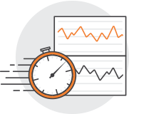
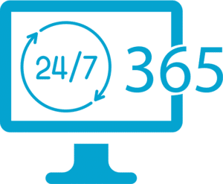
State, District, Taluka
Wise Computations
Based on any particular subject or matter, we can generate comparative figures between desired State, District & Taluka. This will represent the growth analysis by any subject or matter.
Minute-to-Minute
Monitoring
Officers & bearers of organization will have Minute-to-Minute monitoring of activities and transactions happening in the organization. Through Mobile & Web both. This will increase information access for officers.
Data available
24*7
The data will be on cloud and thus available 24*7*365. No hesitations of server down and internet off. Just access your data anytime.
Data Available
Everywhere you go
Your data will be available for you anywhere in the world. At your meetings, on the way, at home, your data is available. You will just need an internet connection. Log in to the system with your credentials and your data will be there.

Slide 4
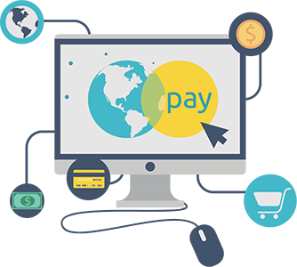
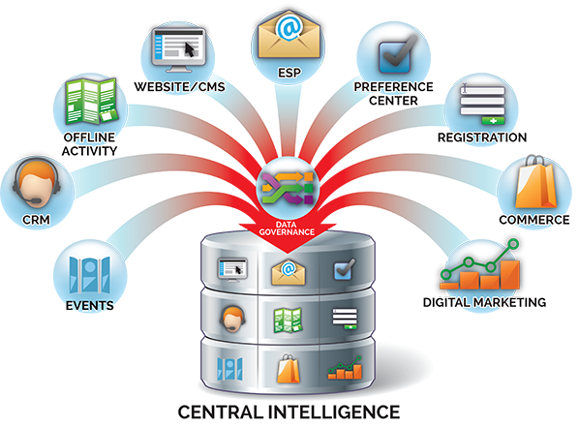
Citizen Centric Services
Available 24*7
Our solution is a web based solution and thus it is very flexible to provide Citizen services on the go to citizens. Citizen can make Applications, Registration, Enquiries, Complaints etc.
24*7 Payment
Gateway
Citizens who wish to pay online, can make payments any time using online payment gateway. This keep the income flowing 24*7 for the organization.
Centralized & Cloud
Data Storage
The data will be stored in a Central server on cloud and thus the Headache of managing and maintaining the local server will be wiped out.
Hi-Fi Hardware
Not Required
Hence it’s a web based solution, your systems are out of compulsion of having met specific hardware requirements. Basic systems with just internet connection will be fine to use our solution.

Slide 5
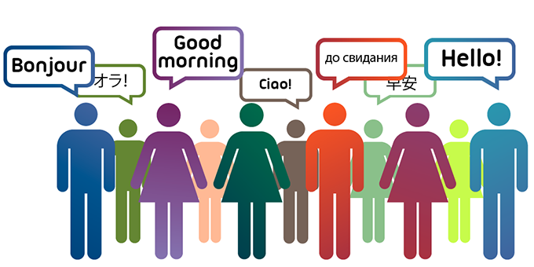
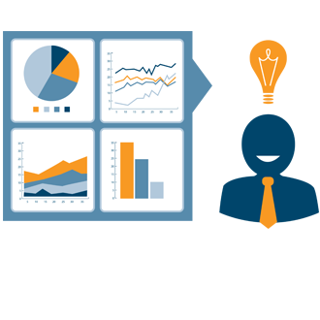
Work From
Home
As our system is available & accessible from anywhere, employees can have access from home & it can increase working efficiency of the organization.
Language Auto
Convert Facility
Our system will be enabled with auto conversion of languages. If user types in Gujarati, it will automatically converted in English and thus the job of typing and managing data in multi-languages will be far easy.
Multi-Lingual
Support
Our System is supported with any language used in India like, Hindi, Gujarati, Tamil, Marathi, Telugu etc. This will enhance user experience and facileness with our system with different languages for different regions of India.
Auto Generation of
Development Reports
On regular intervals, the system will generate different Development reports. This will cover Ward/Area/City/Taluka/District wise Progress reports for different kind of works. This will be available for all top level officers and management teams for analysis.

Slide 6
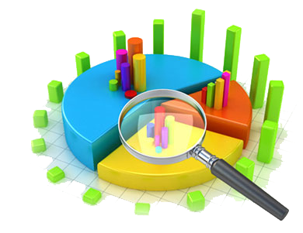
Information
Sharing
Any information that you want to share can be shared with just a few clicks. That is something unique and desirable in this technical era. Sharing on WhatsApp, Facebook, Twitter etc. is now easy with us.
Login for Service
Providers/Contractors
System is feasible to create Service Providers or Contractors logins for sharing and updating their project progress with photos. They can upload photos and it can be viewed for inspection purpose by respective officers immediately.
Digitized Citizen
Applications
All the Applications generated by Citizen will be now in well formatted digitized format and this will improve common flow of Applications for various departments of organization.
Categorized
Analytics
Different analytical reports like, No. of Shops, Type of Professional in Area/City/District. Such analytics can improve information database and can be helpful for specific campaigns of organization.

Slide 7
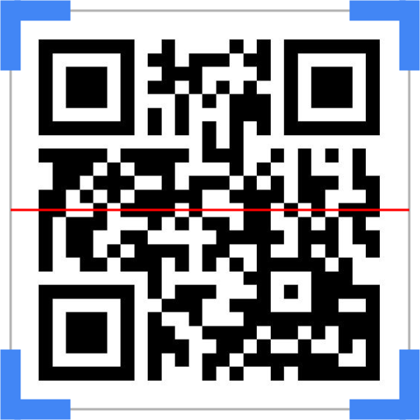
SMS
Integration
SMS will be enabled for all types of transactions made by citizens just like banking. Also bulk SMS will be there to shoot SMS to registered Mobile Nos. This can help share information with everyone within clicks.
QR Code Support
All documents that are dispatching to Citizens / Customers will have the QR Codes on it. And that will be utilized for future transactions using QR Code scanners. This will decrease the chances of errors while making transactions and it will ensure no duplicity happens.
Document Uploads
& Easy Access
All important documents can be scanned and saved department wise. And it can be accessed from anywhere with rights to access. This will stop junky searching of physical documents from files.
Real-Time Application
Tracking
Real-Time tracking of any Application will be easier. Where the application is, which department is hosting it, which is the next department etc. This will improve application flow and System will ensure the timely clearance of applications. System will show Pending, Cleared, Rejected applications.

Slide 8
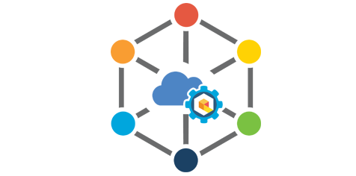
Employee Performance
Evaluation
Based on set parameters, System can generate performance reports for employees and also can rate the employees by performances. This will implement transparent employee bonuses for performances.
Uploading Citizen
Documents
System will have the facility to upload required documents (Aadhar Card ,PAN ,Photo) with every application. That documents will be verified by authorized person and forwarded. This will ensure legal proceedings of any application.
Strong Inter-Department
Integration
Integration among all departments like, Property Tax, Shops, Assets, Professional Tax etc. will be strong and effective. While issuing certificates system will check for Citizen track record with each related department. If fails to meet the criteria, system will notify.
Organizational
Integrity
Governments all organizations will be on single platform through our system. Thus it will be easy to show integral data on single page. For say Chief Minister can be availed with every organization information through single Login.

Slide 9
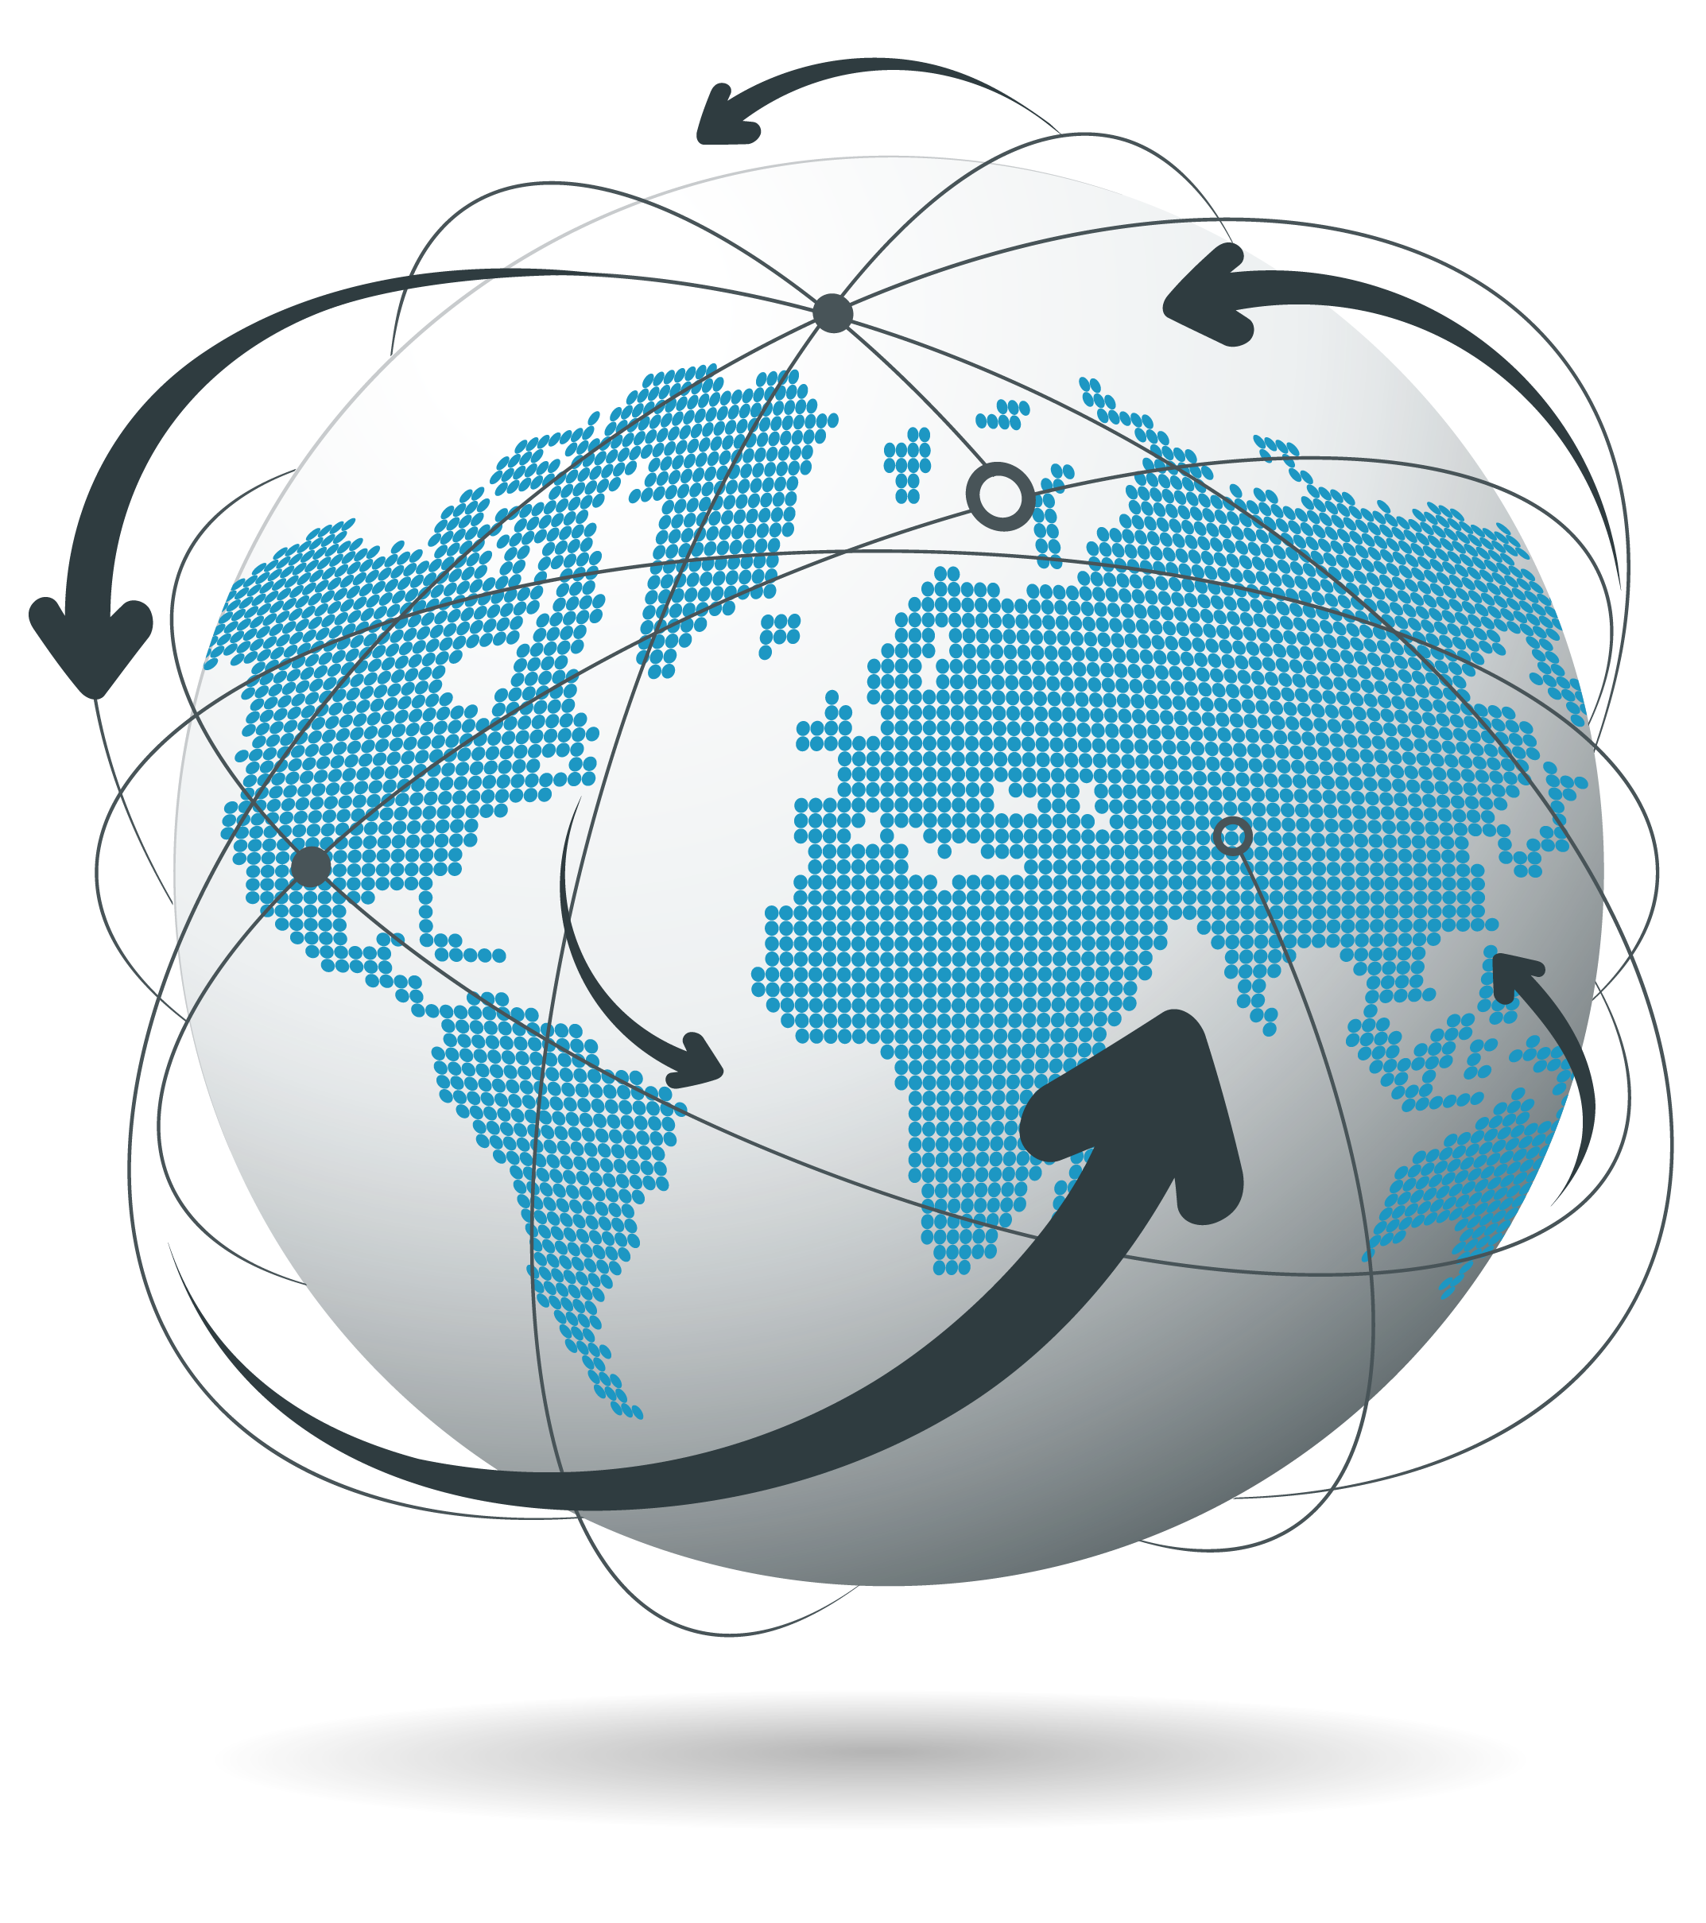
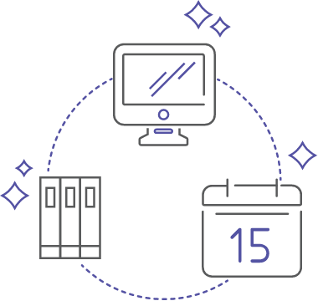
Hierarchy
System will work on Hierarchy. Ministry > Department > Sub Department > Organization > Org. Department > Employee. Every entity from CM to Employee on single platform.
Your E-mail is
Your User Name
Every person will be registered using their E-mail and that E-mail id will be used as User Name for Login. This will erase misinterpretation of Users in the system & will maintain uniqueness. For this a common E-mail id will be generated under the registered domain of the organization.
Future of All
Government platforms
Our System is designed to adopt in every government organization and this will bring revolution in Governance of government organizations.
Integrated Website
Data
With this system, the required data for Website will automatically be generated and the system will be integrated with the website. Data updated in System will be automatically reflected on website without any click.

Slide 10
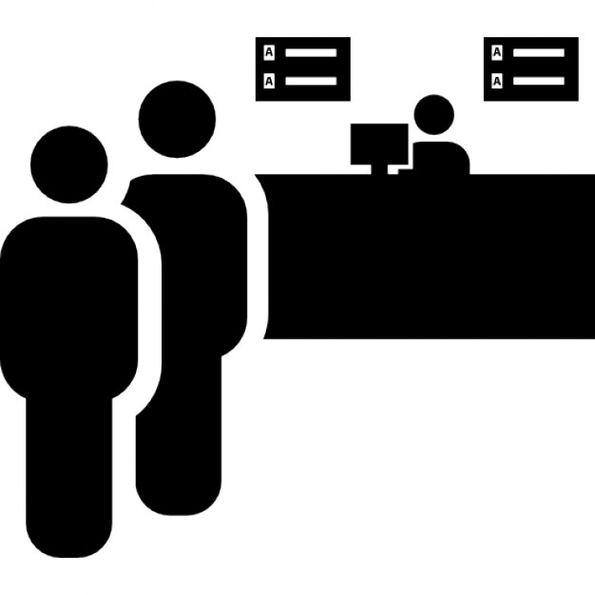
Pay at Bank
Enabling payment counters in Banks will be possible and easy with our system. Different payments can be collected in banks through system interface in banks. This will generate more recovery and awareness.
Civic Centers
For citizen facilitation, launching and running Civic Centers in the city is possible with this system. Our System is flexible to create civic centers wherever required and it will provide easy access to Citizen services.
Live Intra-Chat
Chatting and sharing stuff will be easy with our Intra-Chat feature for employees. They can send messages & attachments to listed all employees of the organization. This will enhance information sharing.
No Re-Work
Our system is designed in a manner that one work done by one employee need not be done by any other employee globally. This is a unique concept for work utilization and we follow the same.

Slide 11
Global Employee ID
Every employee registered with the system will have a Unique Global Employee ID. This will stop duplicity and error in any manner while processing employee data.
Mercury Infoway
B-401, THE CAPITAL,
Opp. Hetarth Party Plot, Science City Road, Ahmedabad
+91 63522 18075
+91 85111 69896

